Slide 1
NLP

Slide 2
Introduction to NLP
Neural Question Answering

Slide 3
MCTest comprehension data
James the Turtle was always getting in trouble. Sometimes he'd reach into the freezer and empty out all the food. Other times he'd sled on the deck and get a splinter. His aunt Jane tried as hard as she could to keep him out of trouble, but he was sneaky and got into lots of trouble behind her back.
One day, James thought he would go into town and see what kind of trouble he could get into. He went to the grocery store and pulled all the pudding off the shelves and ate two jars. Then he walked to the fast food restaurant and ordered 15 bags of fries. He didn't pay, and instead headed home.
His aunt was waiting for him in his room. She told James that she loved him, but he would have to start acting like a well-behaved turtle. After about a month, and after getting into lots of trouble, James finally made up his mind to be a better turtle.
Q: What did James pull off of the shelves in the grocery store?
A) pudding B) fries C) food D) splinters
(Richardson et al.)

Slide 4
bAbI QA (Facebook AI)
John picked up the apple.
John went to the office.
John went to the kitchen.
John dropped the apple.
Q: Where was the apple before the kitchen?
A: office
https://research.fb.com/downloads/babi/

Slide 5
bAbI datasets
1 So they had to fall a long way .
2 So they got their tails fast in their mouths .
3 So they could n't get them out again .
4 That 's all .
5 `` Thank you , " said Alice , `` it 's very interesting .
6 I never knew so much about a whiting before . "
7 `` I can tell you more than that , if you like , " said the Gryphon .
8 `` Do you know why it 's called a whiting ? "
9 `` I never thought about it , " said Alice .
10 `` Why ? "
11 `` IT DOES THE BOOTS AND SHOES . '
12 the Gryphon replied very solemnly .
13 Alice was thoroughly puzzled .
14 `` Does the boots and shoes ! "
15 she repeated in a wondering tone .
16 `` Why , what are YOUR shoes done with ? "
17 said the Gryphon .
18 `` I mean , what makes them so shiny ? "
19 Alice looked down at them , and considered a little before she gave her answer .
20 `` They 're done with blacking , I believe . "
Query: `` Boots and shoes under the sea , " the XXXXX went on in a deep voice , `` are done with a whiting ".
Candidates: Alice|BOOTS|Gryphon|SHOES|answer|fall|mouths|tone|way|whiting
Answer: gryphon

Slide 6
bAbI datasets

Slide 7
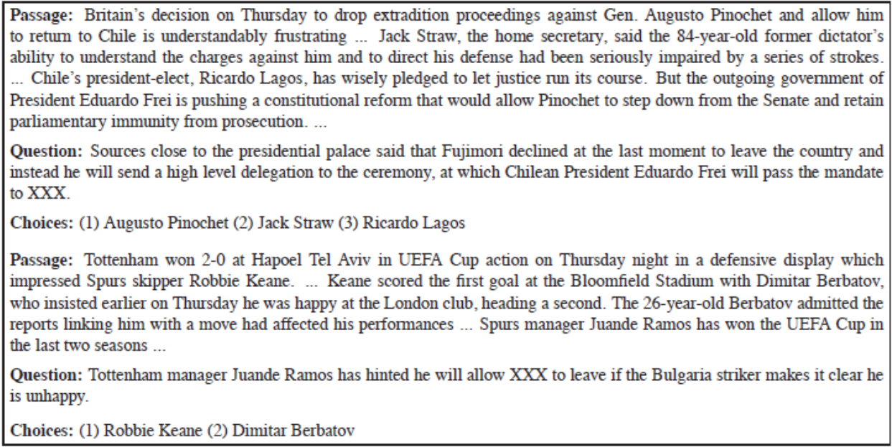
‘Who Did What’ dataset

Slide 8
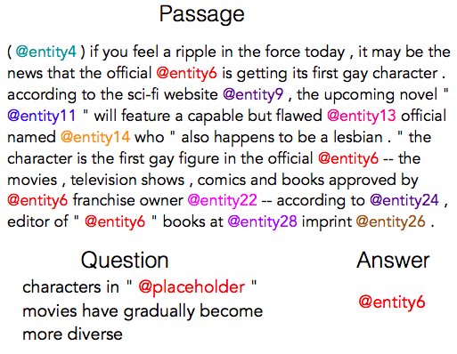
CNN/Daily Mail datasets
https://github.com/deepmind/rc-data
https://cs.nyu.edu/~kcho/DMQA/
https://paperswithcode.com/sota/question-answering-on-cnn-daily-mail

Slide 9
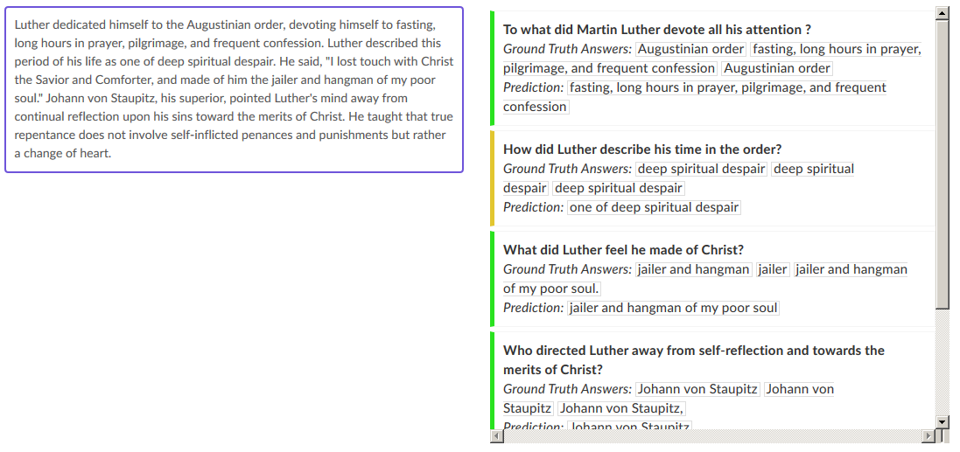
SQuAD dataset

Slide 10
MS Marco dataset
"A corporation is a company or group of people authorized to act as a single entity and recognized as such in law.“
"url“ :
"http://www.wisegeek.com/what-is-a-corporation.htm",
"passage_text“ :
"A company is incorporated in a specific nation, often within the bounds of a smaller subset of that nation, such as a state or province. The corporation is then governed by the laws of incorporation in that state. A corporation may issue stock, either private or public, or may be classified as a non-stock corporation. If stock is issued, the corporation will usually be governed by its shareholders, either directly or indirectly.
"query“ :
". what is a corporation?“
"query_id“ :
1102432
"query_type“ :
"DESCRIPTION"
http://www.msmarco.org/leaders.aspx

Slide 11
EMR QA dataset
[Pampari et al. 2018]

Slide 12
(QANTA): A Neural Network for Factoid Question Answering Over Paragraphs
Application
Answering questions from Quiz Bowl, a high school trivia competition.
The questions in this competition are pyramidal, meaning that the first clues given are very difficult, and later clues progressively become more leading.
Challenge
Develop a model that answers questions based on information that contains very limited key words pertaining to the answer.
Implementation
This model uses a dependency-tree recurrent neural net (DT-RNN) to condense the meaning of phrases into “hidden vectors.”
Iyyer, Mohit et al. “A Neural Network for Factoid Question Answering Over Paragraphs.” 2014.

Slide 13
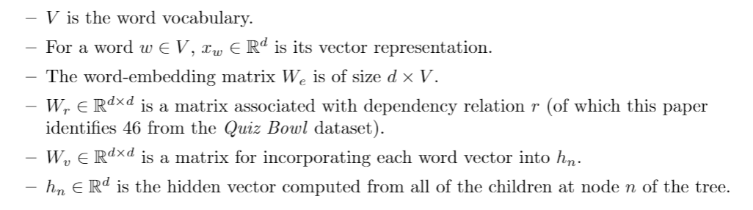
(QANTA): A Neural Network for Factoid Question Answering Over Paragraphs
Iyyer, Mohit et al. “A Neural Network for Factoid Question Answering Over Paragraphs.” 2014.

Slide 14
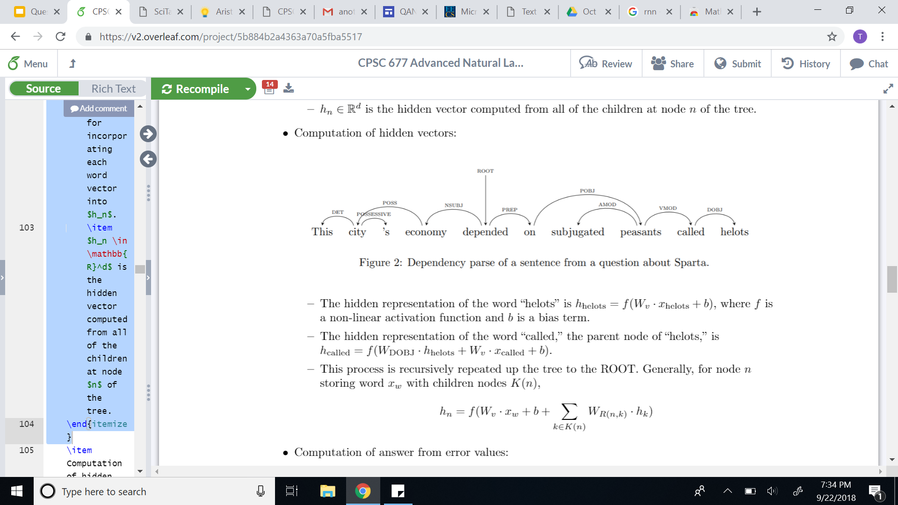
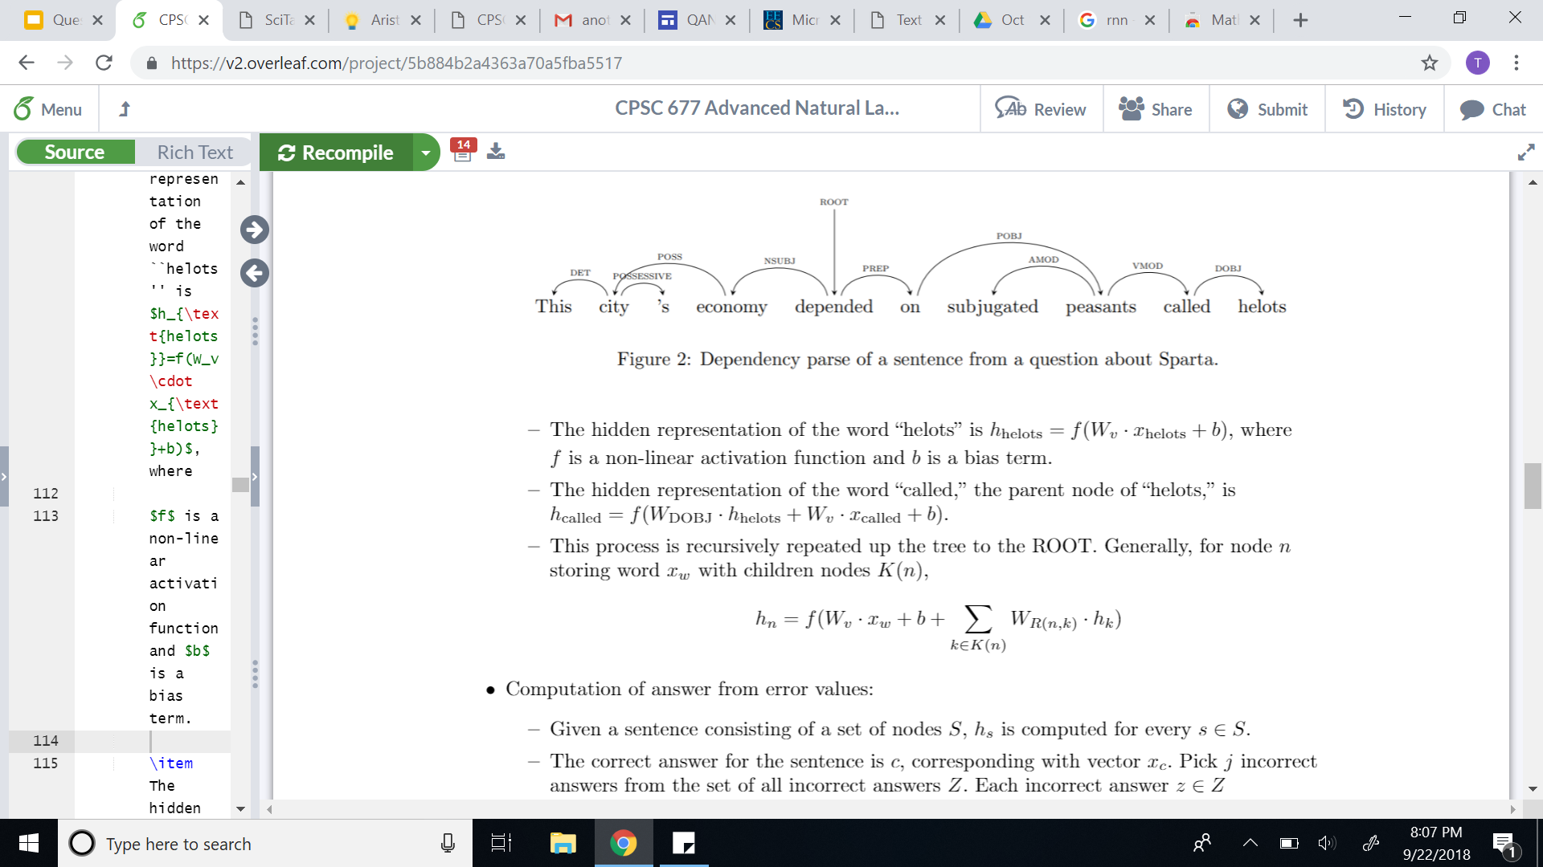
(QANTA): A Neural Network for Factoid Question Answering Over Paragraphs
Recursive computation of hidden vectors:
Iyyer, Mohit et al. “A Neural Network for Factoid Question Answering Over Paragraphs.” 2014.

Slide 15
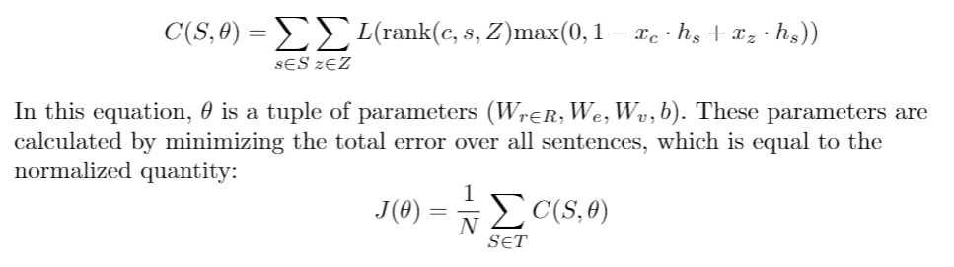
(QANTA): A Neural Network for Factoid Question Answering Over Paragraphs
Computation of parameters from error minimization:
Iyyer, Mohit et al. “A Neural Network for Factoid Question Answering Over Paragraphs.” 2014.

Slide 16
(QANTA): A Neural Network for Factoid Question Answering Over Paragraphs
Experiments
QANTA was trained on questions used in Quiz Bowl tournaments between 1998 and 2013.
Only questions from the History and Literature sections were used (as these were the largest datasets).
Both questions and answers were altered to make keyword recognition more feasible (using Whoosh).
Iyyer, Mohit et al. “A Neural Network for Factoid Question Answering Over Paragraphs.” 2014.

Slide 17
(QANTA): A Neural Network for Factoid Question Answering Over Paragraphs
Sample QuizBowl question:
These substances can use either using a ping-pong mechanism or a ternary complex intermediate.
https://docs.google.com/viewer?a=v&pid=sites&srcid=d2xwcy5uZXR8d2xocy1xdWl6LWJvd2x8Z3g6Mzk2ZmQ5ZTJiMmRjNzljMg

Slide 18
(QANTA): A Neural Network for Factoid Question Answering Over Paragraphs
Sample QuizBowl question:
These substances can use either using a ping-pong mechanism or a ternary complex intermediate.
One model of them defines the parameters K-m and V-max and uses a steady-state approximation.
https://docs.google.com/viewer?a=v&pid=sites&srcid=d2xwcy5uZXR8d2xocy1xdWl6LWJvd2x8Z3g6Mzk2ZmQ5ZTJiMmRjNzljMg

Slide 19
(QANTA): A Neural Network for Factoid Question Answering Over Paragraphs
Sample QuizBowl question:
These substances can use either using a ping-pong mechanism or a ternary complex intermediate.
One model of them defines the parameters K-m and V-max and uses a steady-state approximation.
They can be inhibited non-competitively and competitively, and the change in their structure during substrate binding is described by the (*) induced-fit model. They can be allosterically regulated and perform their action at their active site. For 10 points, name these proteins that catalyze reactions.
https://docs.google.com/viewer?a=v&pid=sites&srcid=d2xwcy5uZXR8d2xocy1xdWl6LWJvd2x8Z3g6Mzk2ZmQ5ZTJiMmRjNzljMg

Slide 20
(QANTA): A Neural Network for Factoid Question Answering Over Paragraphs
Sample QuizBowl question:
ANSWER: Enzymes
https://docs.google.com/viewer?a=v&pid=sites&srcid=d2xwcy5uZXR8d2xocy1xdWl6LWJvd2x8Z3g6Mzk2ZmQ5ZTJiMmRjNzljMg

Slide 21
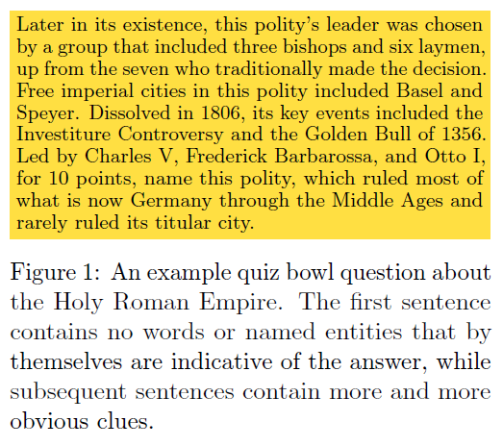
Quiz Bowl Questions
[Iyyer et al. 2014]

Slide 22
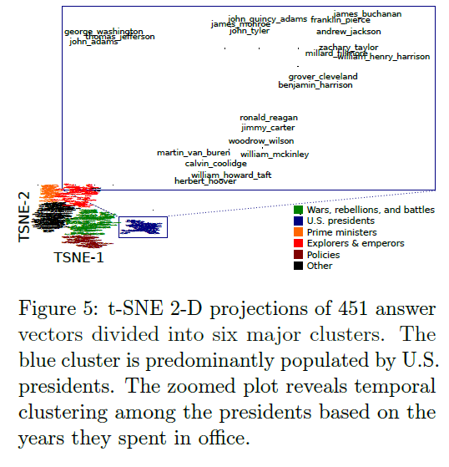
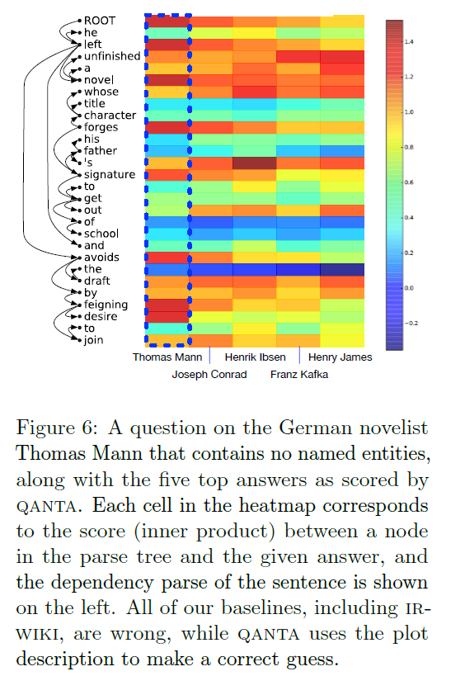
[Iyyer et al. 2014]

Slide 23
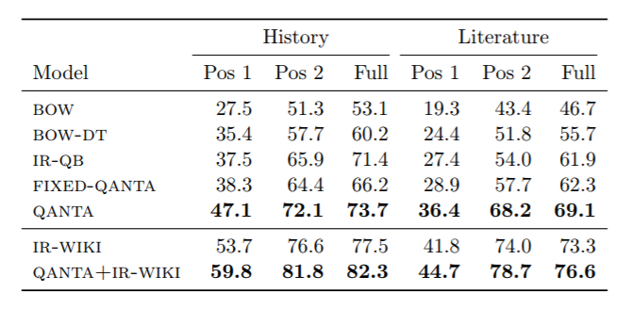
(QANTA): A Neural Network for Factoid Question Answering Over Paragraphs
Performance:
Iyyer, Mohit et al. “A Neural Network for Factoid Question Answering Over Paragraphs.” 2014.

Slide 24
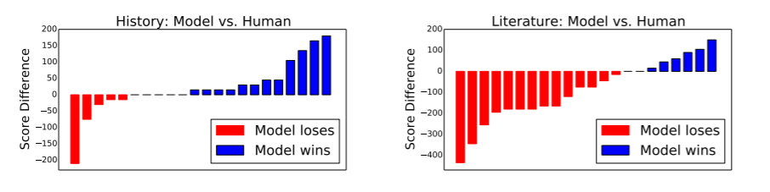
(QANTA): A Neural Network for Factoid Question Answering Over Paragraphs
Performance:
Iyyer, Mohit et al. “A Neural Network for Factoid Question Answering Over Paragraphs.” 2014.

Slide 25
(QANTA): A Neural Network for Factoid Question Answering Over Paragraphs
Summary:
QANTA outperforms BOW and IR models in answering factoid, pyramidal questions.
This paper contributes a model that understands and applies sentence compositionality to question answering.
Iyyer, Mohit et al. “A Neural Network for Factoid Question Answering Over Paragraphs.” 2014.

Slide 26
Links about QANTA
https://cs.umd.edu/~miyyer/qblearn/
A Neural Network for Factoid Question Answering over Paragraphs
Mohit Iyyer, Jordan Boyd-Graber, Leonardo Claudino, Richard Socher, and Hal Daumé III
EMNLP 2014
https://cs.umd.edu/~miyyer/data/question_data.tar.gz
https://cs.umd.edu/~miyyer/qblearn/qanta.tar.gz

Slide 27
(SQuAD): 100,000+ Questions for Machine Comprehension of Text
Application
Reading comprehension, specifically applied to question-answer pairs from Wikipedia articles (cultivated in this dataset).
Challenge
Manually develop a large reading comprehension dataset of quality questions and answers, and derive a model for learning on that dataset.
Implementation
This model uses both dependency and constituency trees, as well as a strong logistic regression model.
Rajpurkar, Pranav. Zhang, Jian. Lopyrev, Konstantin. Liang, Percy. “SQuAD: 100,000+ Questions for Machine Comprehension of Text.” Stanford University, Computer Science Department. 11 October 2016.

Slide 28
(SQuAD): 100,000+ Questions for Machine Comprehension of Text
Existing Datasets:
Hirschman et al. (1999)
Later improved: Riloff and Thelen (2000); Ng et al. (2000)
Richardson et al. (2013): MCTest
Later improved: Narasimhan and Barzilay (2015); Sachan et al. (2015); Wang et al. (2015)
Both data sets are too small to extend to more “expressive” QA modeling systems.
Rajpurkar, Pranav. Zhang, Jian. Lopyrev, Konstantin. Liang, Percy. “SQuAD: 100,000+ Questions for Machine Comprehension of Text.” Stanford University, Computer Science Department. 11 October 2016.

Slide 29
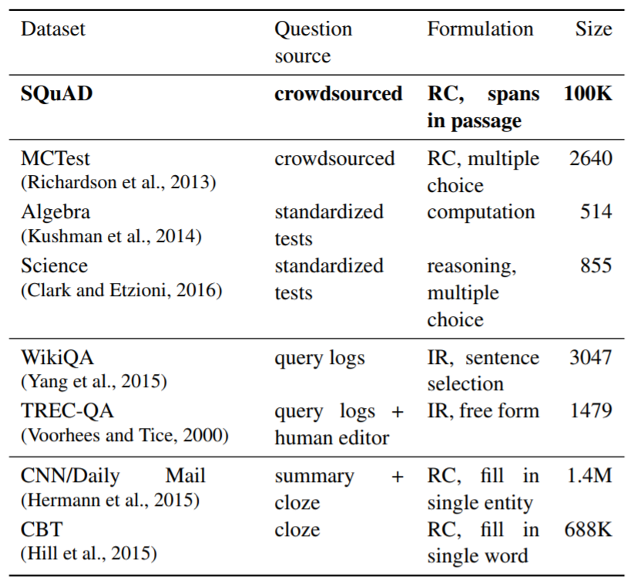
(SQuAD): 100,000+ Questions for Machine Comprehension of Text
Rajpurkar, Pranav. Zhang, Jian. Lopyrev, Konstantin. Liang, Percy. “SQuAD: 100,000+ Questions for Machine Comprehension of Text.” Stanford University, Computer Science Department. 11 October 2016.
Notes:
(Table): “A survey of several reading comprehension and question answering datasets. SQuAD is much larger than all datasets except the semi-synthetic cloze-style datasets, and it is similar to TREC-QA in the open-endedness of the answers.” Ibid.

Slide 30
(SQuAD): 100,000+ Questions for Machine Comprehension of Text
How questions were formulated:
Randomly selected 536 of the 10,000 most visited Wikipedia pages.
Passages of sufficient length were divided into: training set, development set, or test set.
Crowdworkers generated questions that could be answered with a span of text from the passage.
Other crowdworkers were then used to select alternate answer choices (spans from the text)
Rajpurkar, Pranav. Zhang, Jian. Lopyrev, Konstantin. Liang, Percy. “SQuAD: 100,000+ Questions for Machine Comprehension of Text.” Stanford University, Computer Science Department. 11 October 2016.

Slide 31
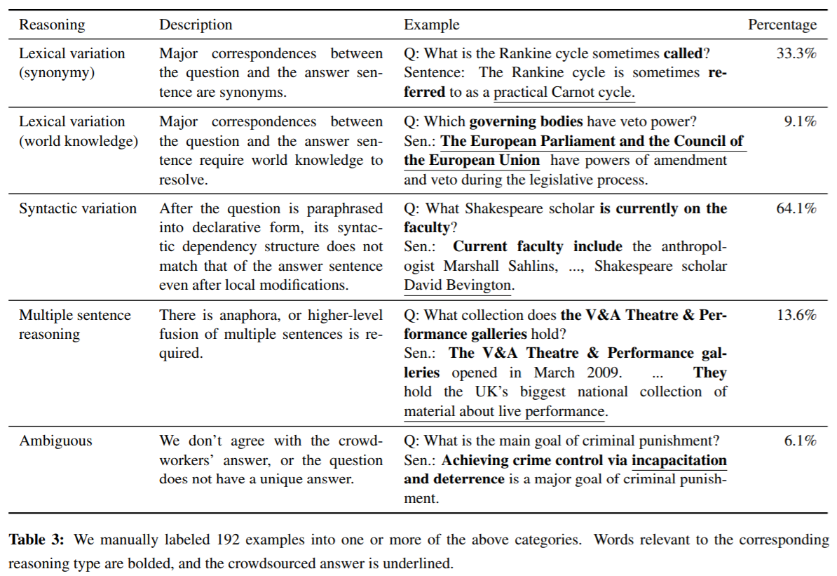
(SQuAD): 100,000+ Questions for Machine Comprehension of Text
Rajpurkar, Pranav. Zhang, Jian. Lopyrev, Konstantin. Liang, Percy. “SQuAD: 100,000+ Questions for Machine Comprehension of Text.” Stanford University, Computer Science Department. 11 October 2016.
Notes:
(Table): “A survey of several reading comprehension and question answering datasets. SQuAD is much larger than all datasets except the semi-synthetic cloze-style datasets, and it is similar to TREC-QA in the open-endedness of the answers.” Ibid.

Slide 32
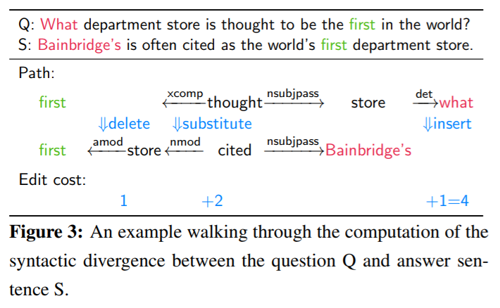
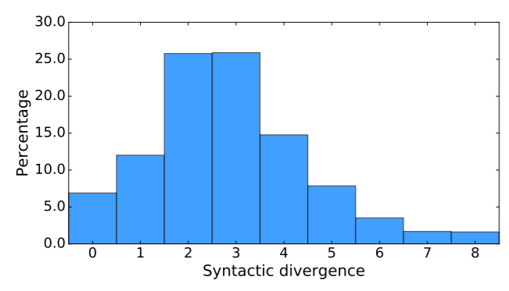
(SQuAD): 100,000+ Questions for Machine Comprehension of Text
Measurement of syntactic divergence:
Rajpurkar, Pranav. Zhang, Jian. Lopyrev, Konstantin. Liang, Percy. “SQuAD: 100,000+ Questions for Machine Comprehension of Text.” Stanford University, Computer Science Department. 11 October 2016.

Slide 33
(SQuAD): 100,000+ Questions for Machine Comprehension of Text
Method:
Develop a set of candidate sentence spans using Stanford CoreNLP.
Apply sliding window approach (Richardson et al.) to get best candidates.
Apply logistic regression model.
Evaluate performance.
Rajpurkar, Pranav. Zhang, Jian. Lopyrev, Konstantin. Liang, Percy. “SQuAD: 100,000+ Questions for Machine Comprehension of Text.” Stanford University, Computer Science Department. 11 October 2016.

Slide 34
(SQuAD): 100,000+ Questions for Machine Comprehension of Text
Logistic regression model:
Candidate answers were evaluated based on certain features.
The model was then trained on the answer choices using AdaGrad (gradient-based optimization algorithm).
L₂ regularization is used in training the model.
Features:
Matching Word/Bigram Frequencies
Root Match
Lengths
Span Word Frequencies
Constituent Label
Span POS Tags
Lexicalized
Dependency Tree Paths
Rajpurkar, Pranav. Zhang, Jian. Lopyrev, Konstantin. Liang, Percy. “SQuAD: 100,000+ Questions for Machine Comprehension of Text.” Stanford University, Computer Science Department. 11 October 2016.

Slide 35
(SQuAD): 100,000+ Questions for Machine Comprehension of Text
Experiments and results:
Used exact match and F1 score to evaluate accuracy.
The results of the logistic regression model were compared with both baseline performance and human performance.
A procedure called “feature ablations” was used to determine on which features the model performed the highest.
The authors also analyzed performance based on answer type.
Rajpurkar, Pranav. Zhang, Jian. Lopyrev, Konstantin. Liang, Percy. “SQuAD: 100,000+ Questions for Machine Comprehension of Text.” Stanford University, Computer Science Department. 11 October 2016.

Slide 36
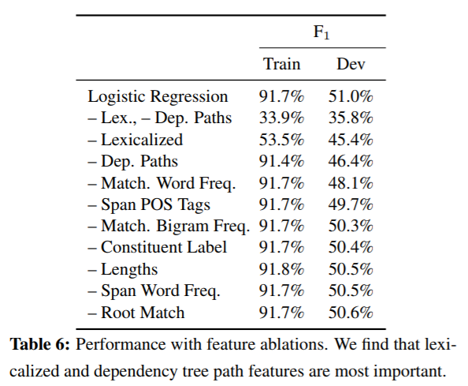
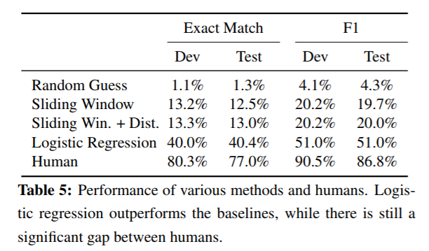
(SQuAD): 100,000+ Questions for Machine Comprehension of Text
Rajpurkar, Pranav. Zhang, Jian. Lopyrev, Konstantin. Liang, Percy. “SQuAD: 100,000+ Questions for Machine Comprehension of Text.” Stanford University, Computer Science Department. 11 October 2016.

Slide 37
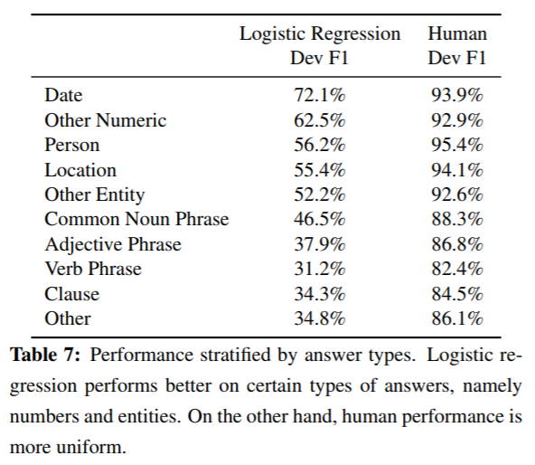
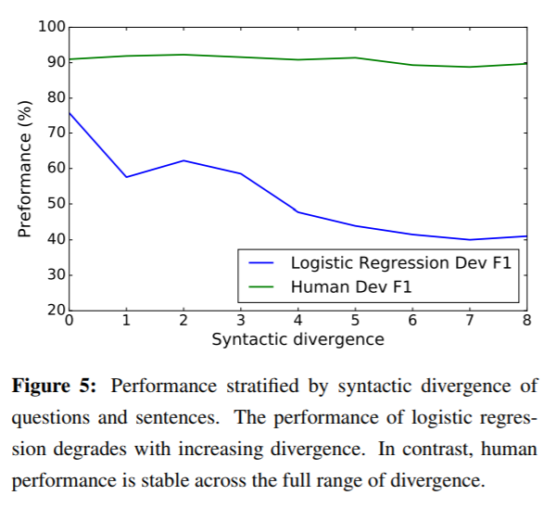
(SQuAD): 100,000+ Questions for Machine Comprehension of Text
Rajpurkar, Pranav. Zhang, Jian. Lopyrev, Konstantin. Liang, Percy. “SQuAD: 100,000+ Questions for Machine Comprehension of Text.” Stanford University, Computer Science Department. 11 October 2016.

Slide 38
(SQuAD): 100,000+ Questions for Machine Comprehension of Text
Summary:
This paper contributes a question answering dataset based on Wikipedia articles that has crowdsourced question-answer pairs.
This dataset is public and many other papers use it to test their own models.
The logistic regression model outperforms the baseline, but is far from human performance.
However, since the paper was published in 2016, the gap between this model’s performance and human performance has more than halved.
Rajpurkar, Pranav. Zhang, Jian. Lopyrev, Konstantin. Liang, Percy. “SQuAD: 100,000+ Questions for Machine Comprehension of Text.” Stanford University, Computer Science Department. 11 October 2016.

Slide 39
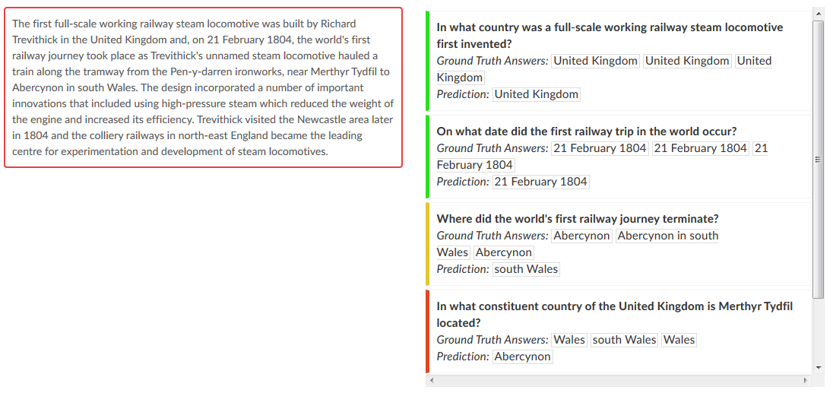
Stanford QA corpus
[Rajpurkar et al. 2016]

Slide 40
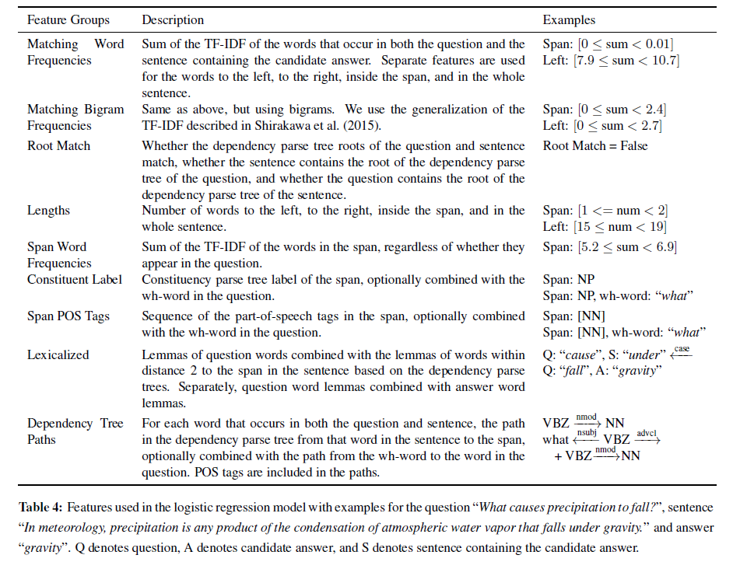
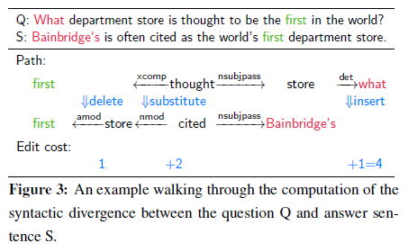
[Rajpurkar et al. 2016]

Slide 41
NLP

